Slide 1
SORTING
BHAVANA
DAY 8
12/04/2024

Slide 2
INSERTION SORT:
Idea: like sorting a hand of playing cards
Start with an empty left hand and the cards facing down on the table.
Remove one card at a time from the table, and insert it into the correct position in the left hand
compare it with each of the cards already in the hand, from right to left
The cards held in the left hand are sorted
these cards were originally the top cards of the pile on the table
Advantages
Good running time for “almost sorted” arrays Θ(n)
Disadvantages
Θ(n²) running time in worst and average case
≈ n²/2 comparisons and exchanges

Slide 3
ALGORITHM:
Step 1 − If it is the first element, it is already sorted. return 1;
Step 2 − Pick next element
Step 3 − Compare with all elements in the sorted sub-list
Step 4 − Shift all the elements in the sorted sub-list that is greater than the value to be sorted
Step 5 − Insert the value
Step 6 − Repeat until list is sorted

Slide 4
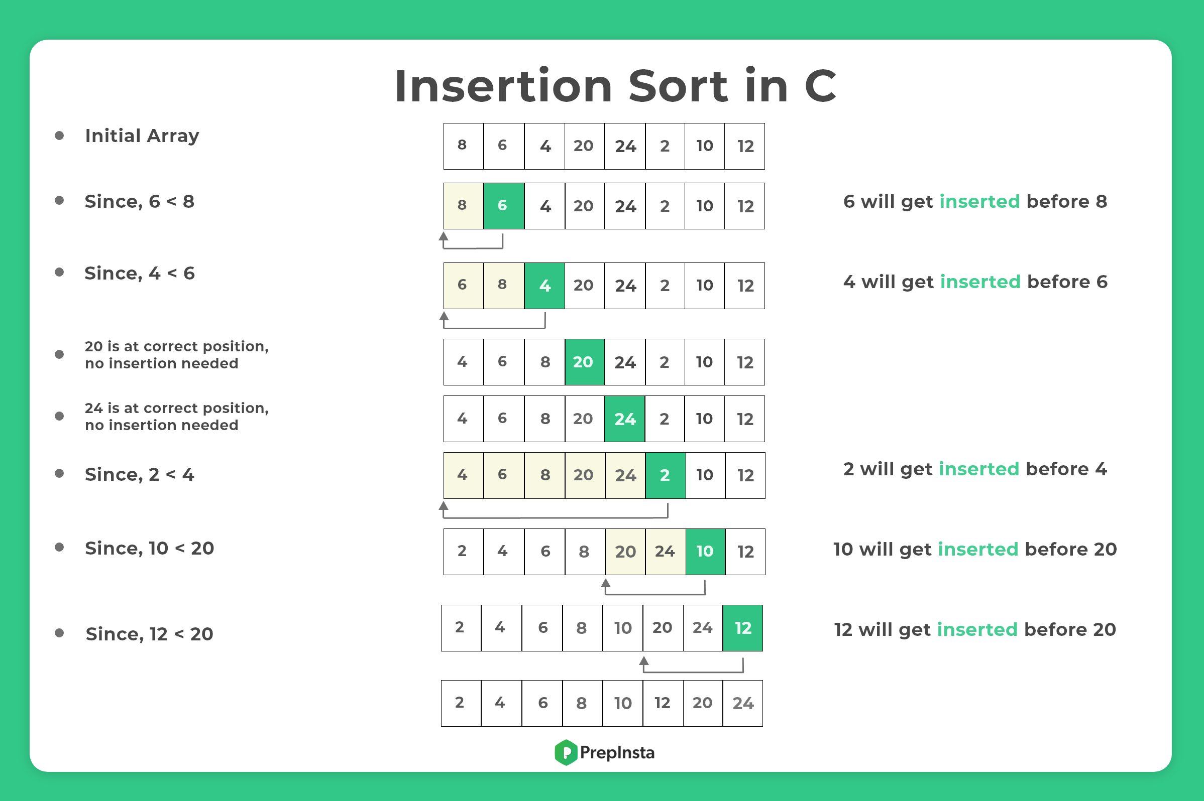

Slide 5
BUBBLE SORT:
Idea:
Repeatedly pass through the array
Swaps adjacent elements that are out of order
Easier to implement, but slower than Insertion sort
ALGORITHM:
Step 1 − Check if the first element in the input array is greater than the next element in the array.
Step 2 − If it is greater, swap the two elements; otherwise move the pointer forward in the array.
Step 3 − Repeat Step 2 until we reach the end of the array.
Step 4 − Check if the elements are sorted; if not, repeat the same process (Step 1 to Step 3) from the last element of the array to the first.
Step 5 − The final output achieved is the sorted array.

Slide 6
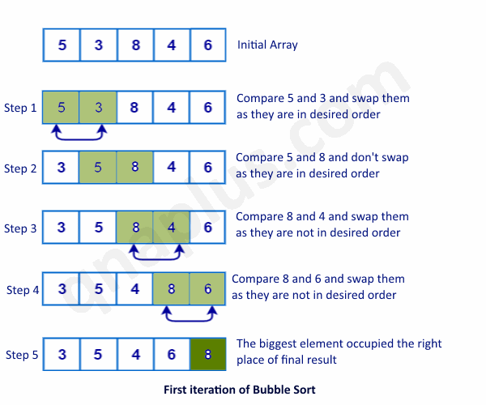

Slide 7
SELECTION SORT
Idea:
Find the smallest element in the array
Exchange it with the element in the first position
Find the second smallest element and exchange it with the element in the second position
Continue until the array is sorted
Disadvantage:
Running time depends only slightly on the amount of order in the file

Slide 8
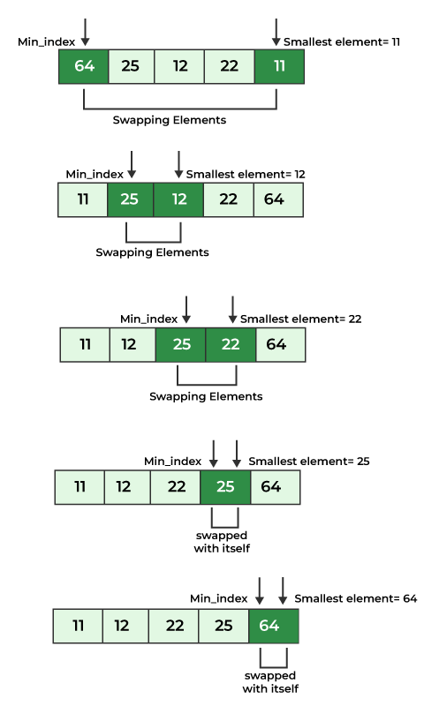
ALGORITHM:
Set MIN to location 0.
Search the minimum element in the list.
Swap with value at location MIN.
Increment MIN to point to next element.
Repeat until the list is sorted.

Slide 9
DIFFERENCE BETWEEN BUBBLE SORT AND INSERTION SORT
S.NO. | Bubble Sort | Insertion Sort
1 | It is a comparison-based sorting algorithm in which we have to compare adjacent elements, and depending on the wrong order, we need to swap the elements. | An easy sorting technique that constructs the final sorted list by moving one element at a time.
2 | In the bubble sort algorithm, we check the neighbour element and swap them if required. | In the insertion sort, we transfer an element at one time to construct a sorted array.
3 | It includes more swaps. | It includes less number of swaps.
4 | It is slow as compared to the insertion sort. | It is fast as compared to bubble sort.

Slide 10
MERGESORT:
MergeSort is a recursive sorting procedure that uses at most O(n lg(n)) comparisons.
To sort an array of n elements, we perform the following steps in sequence:
If n < 2 then the array is already sorted.
Otherwise, n > 1, and we perform the following three steps in sequence:
Sort the left half of the the array using MergeSort.
Sort the right half of the the array using MergeSort.
Merge the sorted left and right halves.

Slide 11
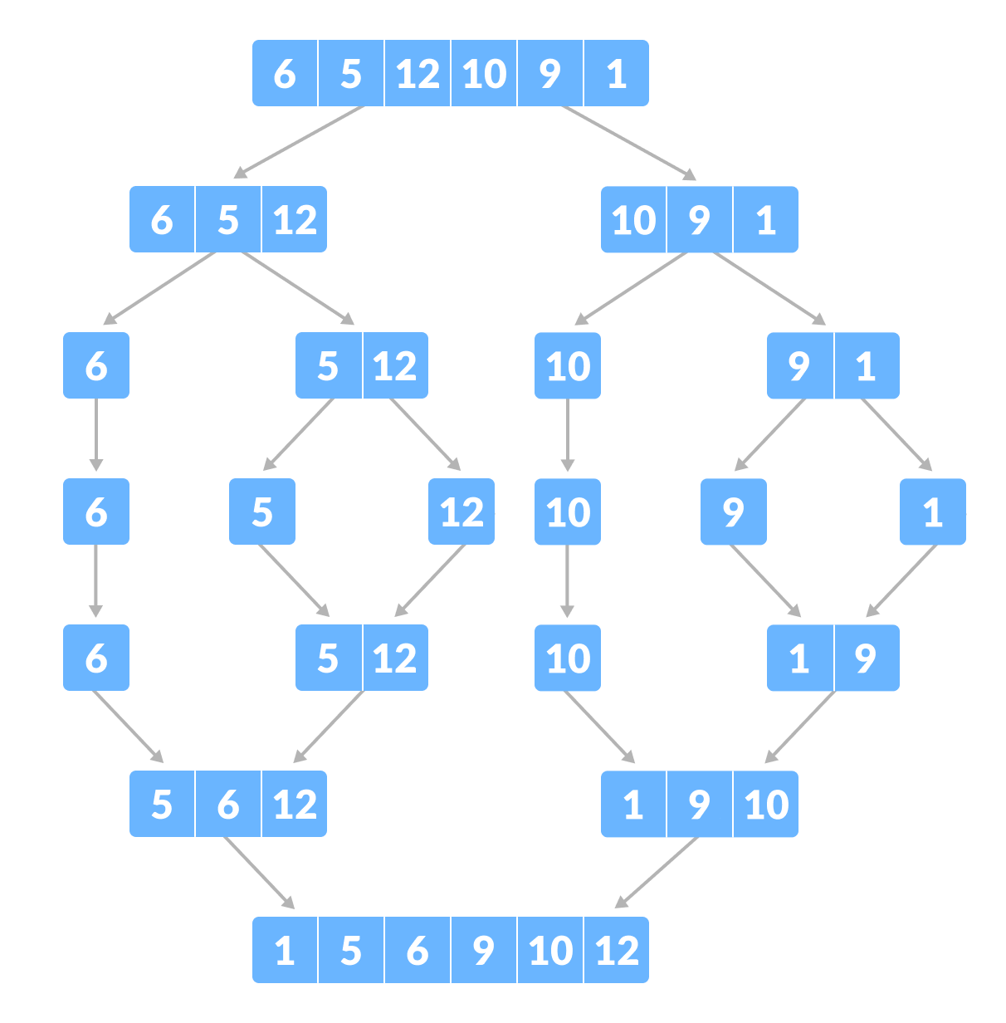

Slide 12
QUICK SORT :
ALGORITHM
Given an array of n elements (e.g., integers):
If array only contains one element, return
Else
pick one element to use as pivot.
Partition elements into two sub-arrays:
Elements less than or equal to pivot
Elements greater than pivot
Quicksort two sub-arrays
Return results

Slide 13
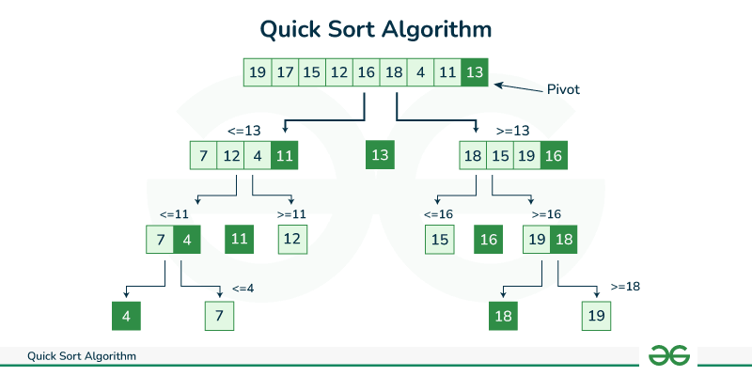

Slide 14
HEAP SORT:
EXAMPLE:
1. Initial Array:
Original Array: { 12, 11, 13, 5, 6, 7 }
2. Heapifying the Array:
- We start by calling ‘heapify(arr, 6, 0)’ to heapify the entire array.
Here, ‘n = 6’ (size of the array) and ‘i = 0’ (index of the root node).

Slide 15
- Iteration 1 :(for the root node with value 12):
- ‘largest = 0’, ‘left = 2 * 0 + 1 = 1’, ‘right = 2 * 0 + 2 = 2’.
- Compare ‘arr[1]’ (value 11) and ‘arr[0]’ (value 12).
Since ‘arr[1]’ is smaller, update ‘largest = 1’.
- Swap ‘arr[0]’ (value 12) and ‘arr[1]’ (value 11).
- Recursively call ‘heapify(arr, 6, 1)’ to heapify the subtree rooted at index 1.
- Iteration 2:
(for the subtree rooted at index 1 with value 11):
- ‘largest = 1’, ‘left = 2 * 1 + 1 = 3’, ‘right = 2 * 1 + 2 = 4’.
- Compare ‘arr[3]’ (value 5) and ‘arr[1]’ (value 11).
Since ‘arr[3]’ is smaller, update ‘largest = 3’.
- Swap ‘arr[1]’ (value 11) and ‘arr[3]’ (value 5).
- Recursively call ‘heapify(arr, 6, 3)’ to heapify the subtree rooted at index 3.

Slide 16
- Iteration 3:
(for the subtree rooted at index 3 with value 5):
- Since index 3 is a leaf node, no further recursion is performed.
3. Heapified Array:
Max Heap: { 13, 11, 12, 5, 6, 7 }

Slide 17
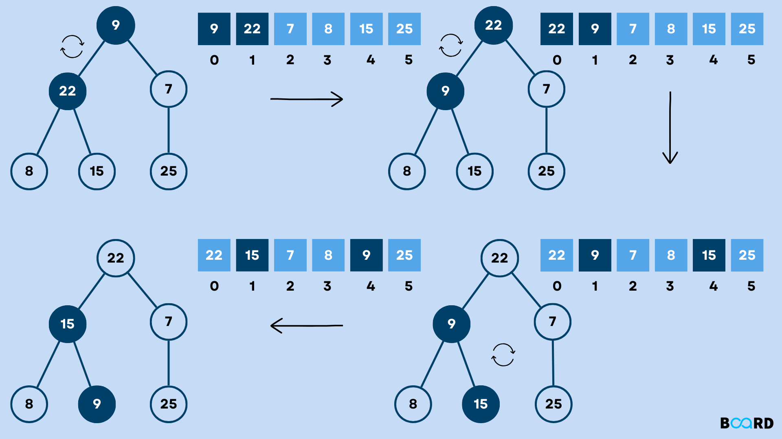

Slide 18
Algorithm: Heapsort(A)
BUILD-MAX-HEAP(A)
for i = A.length downto 2
exchange A[1] with A[i]
A.heap-size = A.heap-size - 1 MAX-HEAPIFY(A, 1)

Slide 19


